Slide 1


PHISHING WEBSITE DETECTION
From Research to Production-Ready Pipeline
Meir Gamla | February 2026

Slide 2





INTRODUCTION & MOTIVATION
PROBLEM & CHALLENGE
>
Phishing – a leading cause of data breaches.
>
The Challenge: Attackers constantly evolve URL patterns to evade static detection rules.
PROJECT GOAL
>
Leverage a Data Article for phishing detection.
>
Build a robust, end-to-end ML pipeline.
>
Analyze feature importance and other additive aspects beyond the baseline paper.

Slide 3
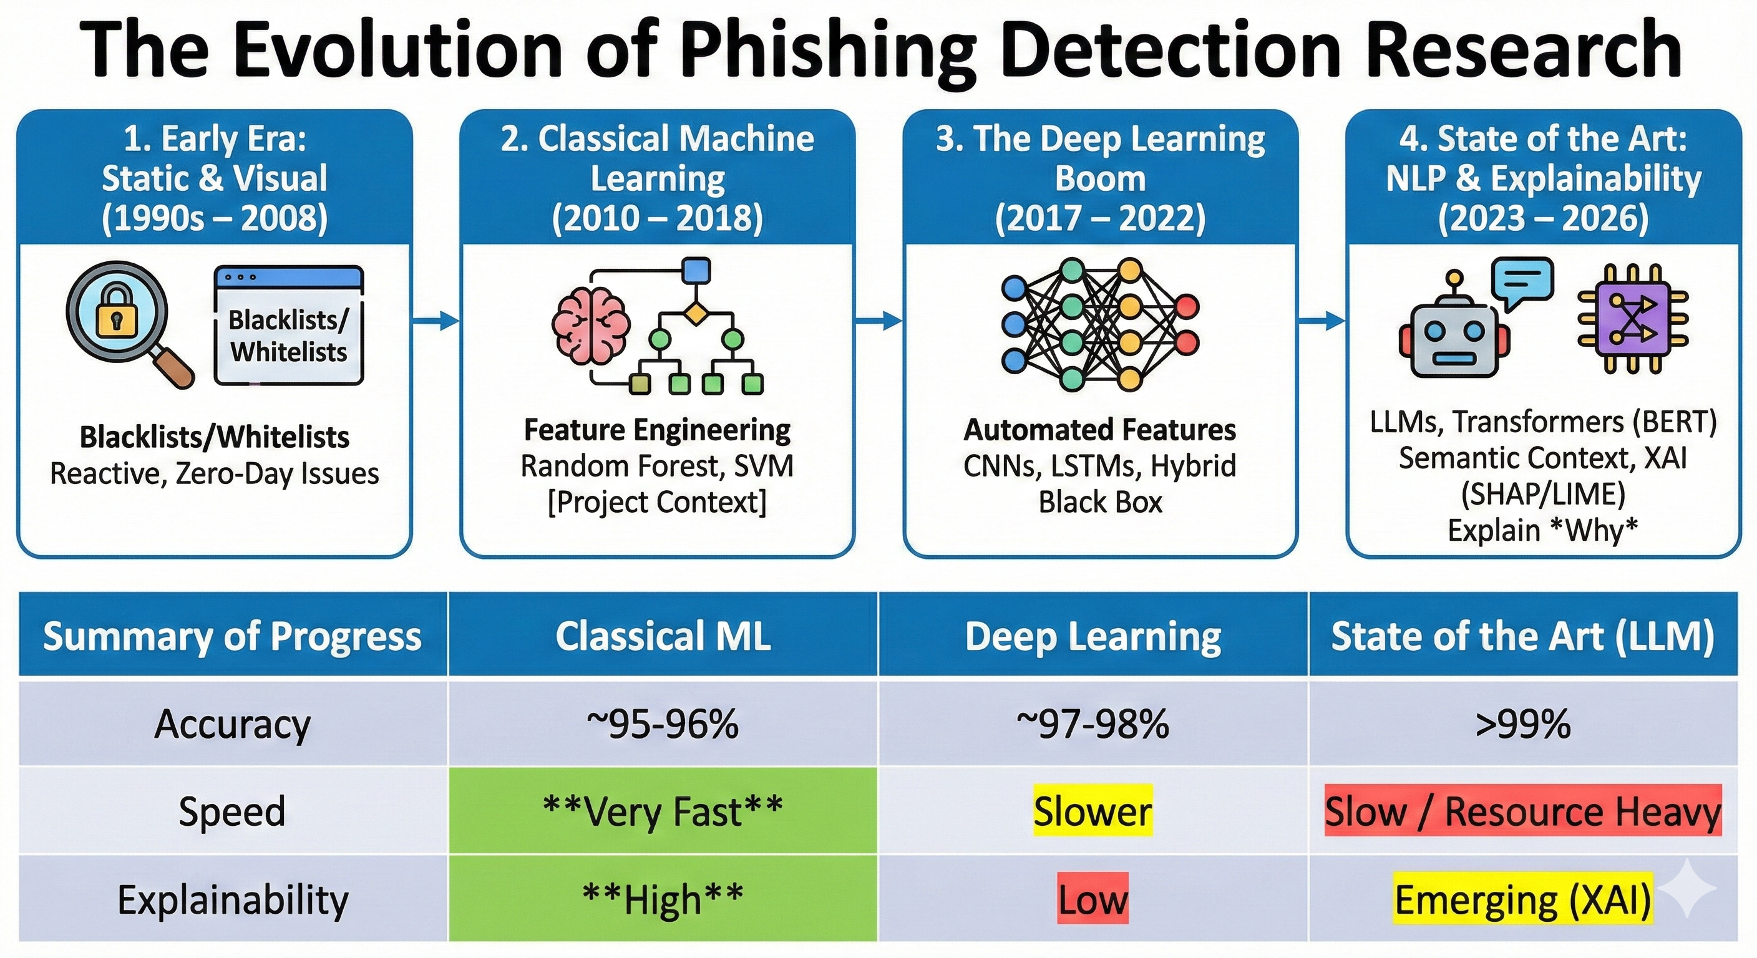






INSTEAD OF RELATED WORK

Slide 4

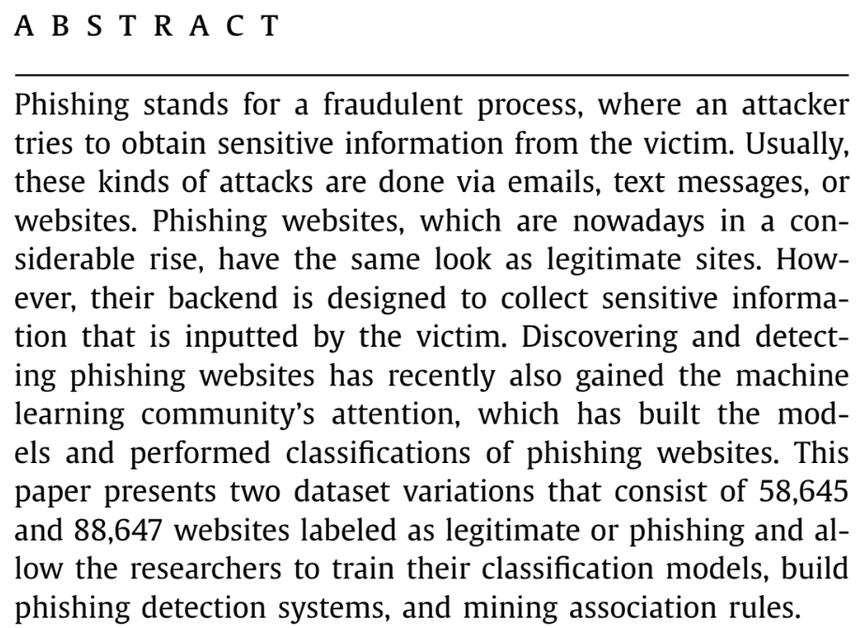
THE RESEARCH PAPER
>
“Datasets for phishing websites detection”, by Vrbančič at all (Data in Brief, 2020).
>
148 citations
>
Provided datasets of legitimate vs. phishing instances, represented as extracted features.
>
Features based on URL structure, domain attributes, and external services.

Slide 5
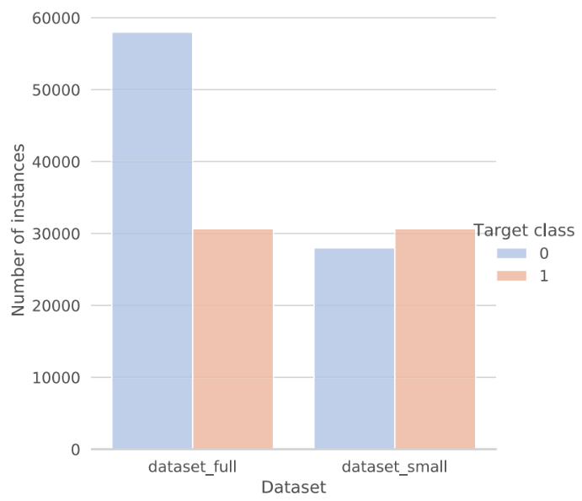

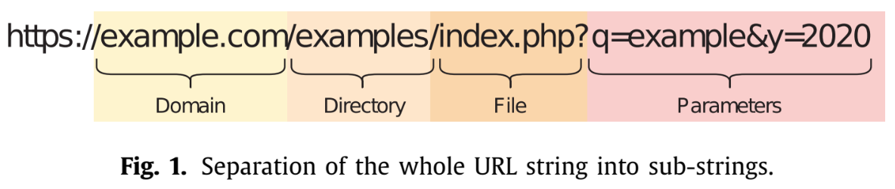
THE DATASET
>
Source: Mendeley Data, 88,647 instances
>
Classes: Legitimate (58k) vs. Phishing (30k)
>
Class Ratio ~65% / 35% (Imbalanced but manageable)
>
111 features:
>
Simple URL Structure + External Services
Entire URL
E

Slide 6
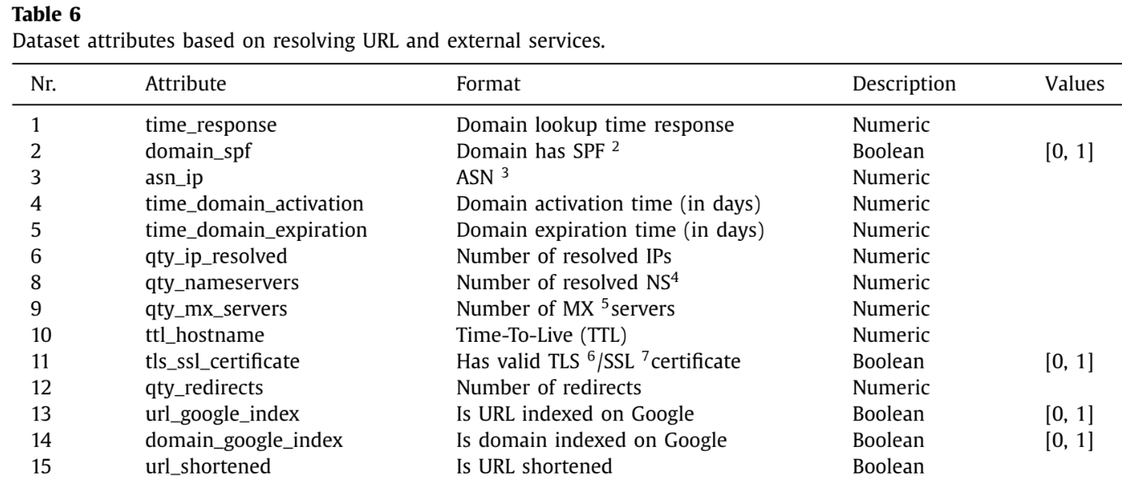


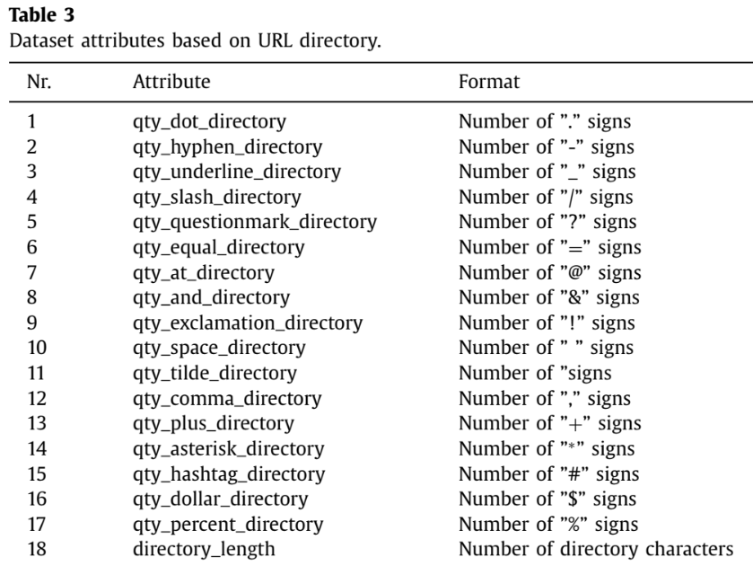
EXAMPLE OF FEATURES
linked
linked
of domain’s DNS record
when loading
2) Email phishing prevention mechanism.
3) Unique identifier for an independent internet network.
4) Nameservers - servers that manage link between
domain name and its IP.
5) Number of mail exchange servers for the domain
(used for backup or load sharing).

Slide 7
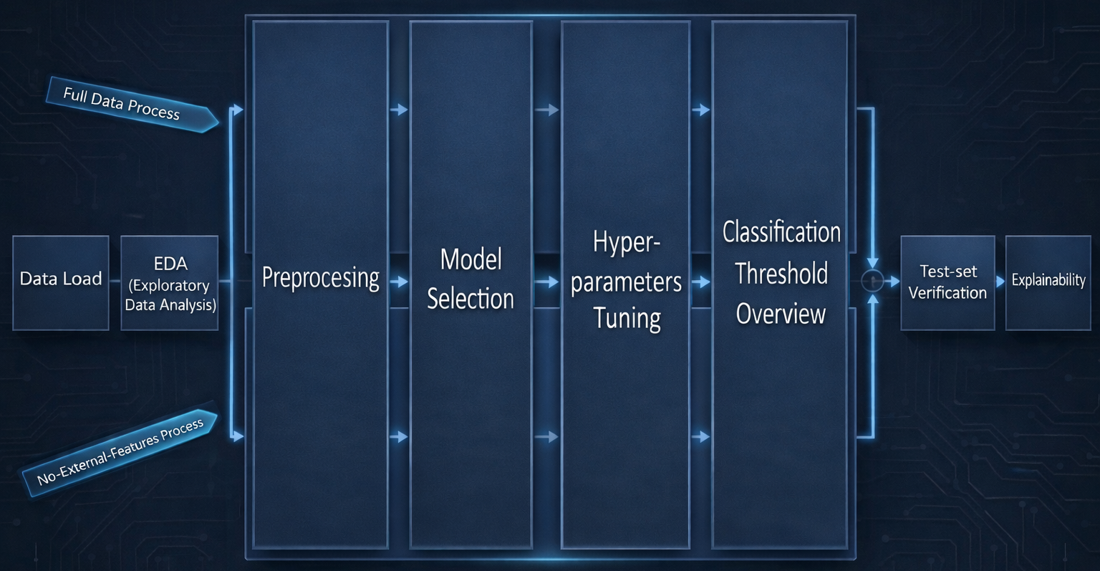
METHODOLOGY & PIPELINE
CODE STRUCTURE:
Modular Python project
Pipeline ensures reproducibility

Slide 8
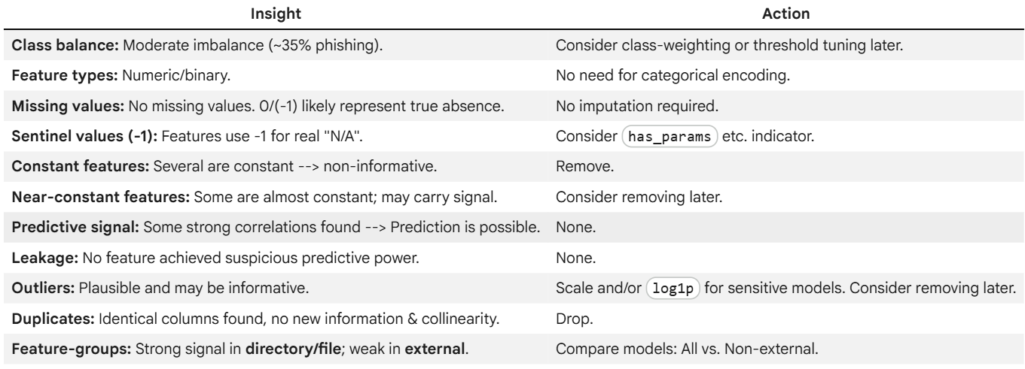
FIRST STEPS
Split: Train (70%), Validation (15%), Test (15%).
EDA:

Slide 9

PREPROCESSING
Rows Deduplication
~1,400 duplicates
Columns Deduplication (5)
Constant columns removal (13)
-1 treatment
Add indicator has_[group] & replace -1 → 0 to prevent misinterpretation (10)
Scaling (inside model-specific pipeline)

Slide 10
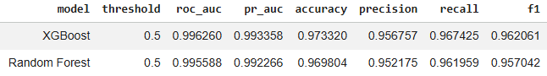
MODELING STRATEGY
MODEL SELECTION
METRICS
Tested 4 baselines (ordered by performance):
>
Accuracy: % correct predictions.
>
Precision: True ‘phishing’ alarm (out of all alarms).
>
SVM
>
Recall: Phishing catches (out of all phishing).
>
Logistic Regression
>
F1-Score: Balance of Precision/Recall.
>
XGBoost
>
AUCROC: Class separation ability.
>
Random Forest
>
PRAUC: Performance on imbalanced data.
XGBoost & RF continued to hyperparameter tuning (3-fold CV) & evaluated on the Validation set.

Slide 11

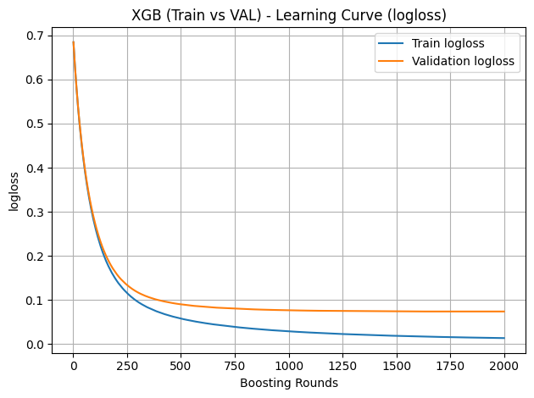
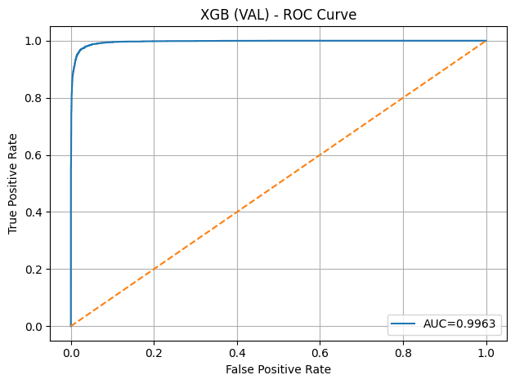

Slide 12

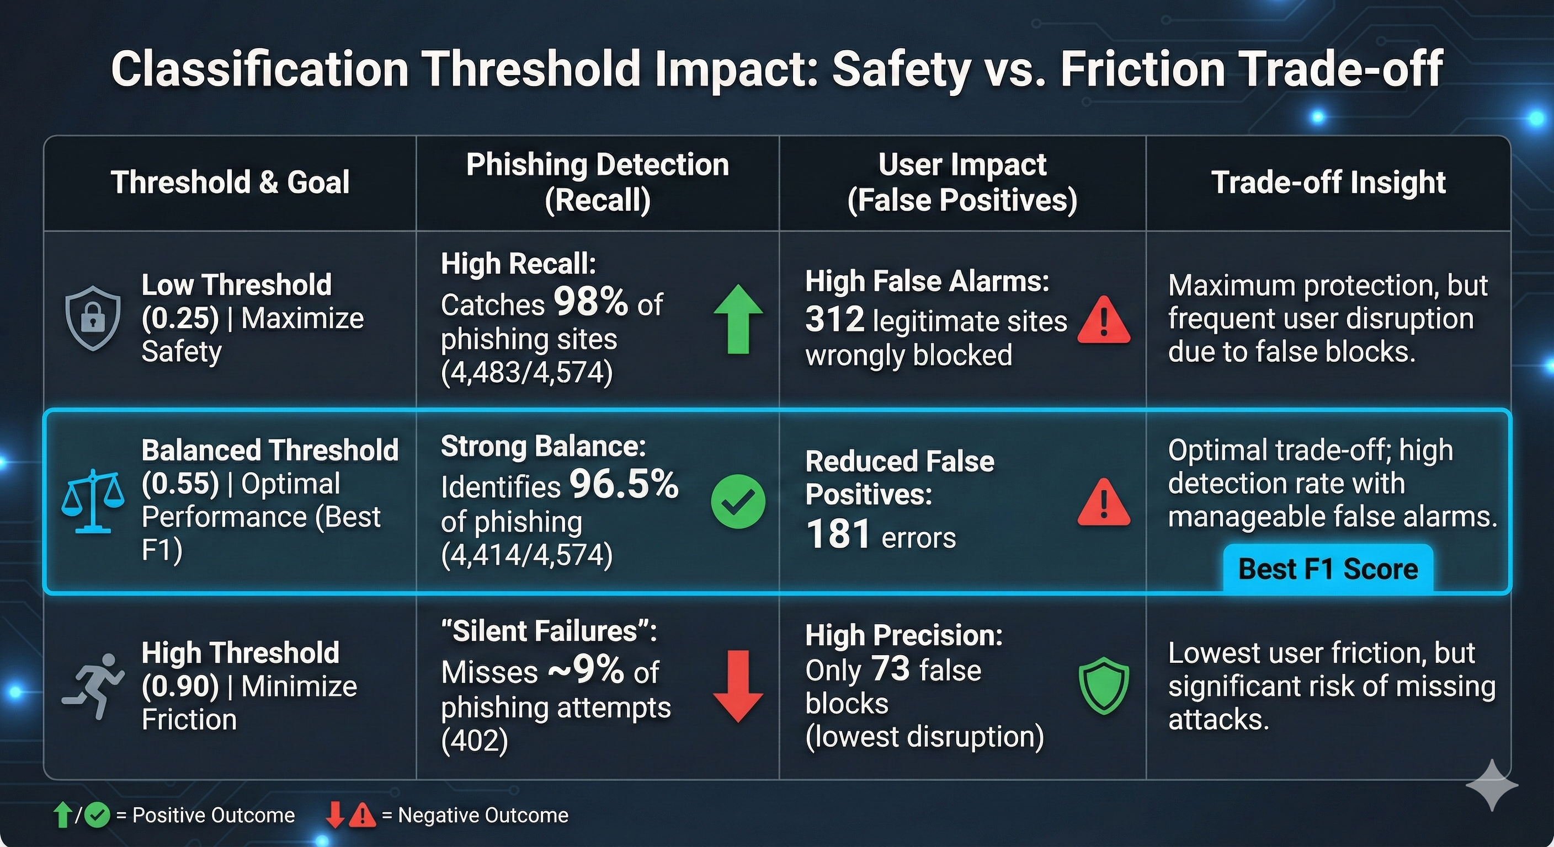
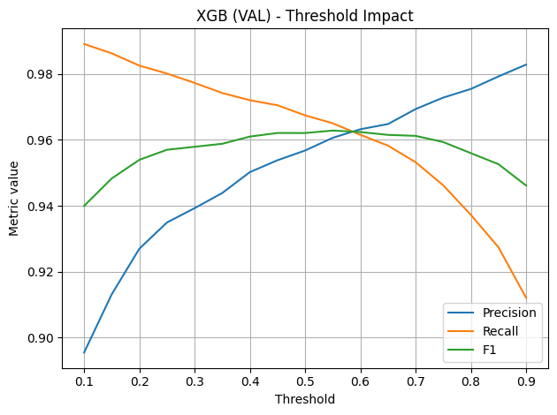
CLASSIFICATION THRESHOLD IMPACT

Slide 13
NO-EXTERNAL-FEATURES CHECK
GOAL & PROCESS
>
Goal: Evaluate importance of expensive features (0.5–2.0s per URL, sometimes money).
>
Process:
Reduced feature set to 81 (internal only).
Rerun entire procedure (only XGBoost).
RESULTS
>
>
Performance Drop: 2-10% in metrics.
>
>
Threshold Shift: Requires more extreme values to achieve similar safety.
>
Example: To maintain high Recall, threshold must drop from 0.25 → 0.1 (increasing FP).

Slide 14
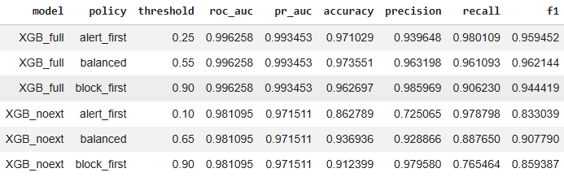

FINAL RESULTS – TEST SET
TAKEAWAY
>
Full model: good performance, low overfitting, only simple preprocessing.
URL structure + lightweight metadata: highly informative, without analyzing content.
>
External features add meaningful discrimination. Especially important for "Block-first".
No-External Model Uses: alerting, fallback when external lookups fail, fast "First Layer" filter.
>
>

Slide 15
SHAP BACKGROUND
Quantifies each feature’s contribution to a prediction (Game Theory)
Based on averaging marginal effects over all feature combinations
F – set of all features | S – subset | f(S) - prediction using only S
i – features index
Model-agnostic and suitable for non-linear ensembles
>
>
>

Slide 16
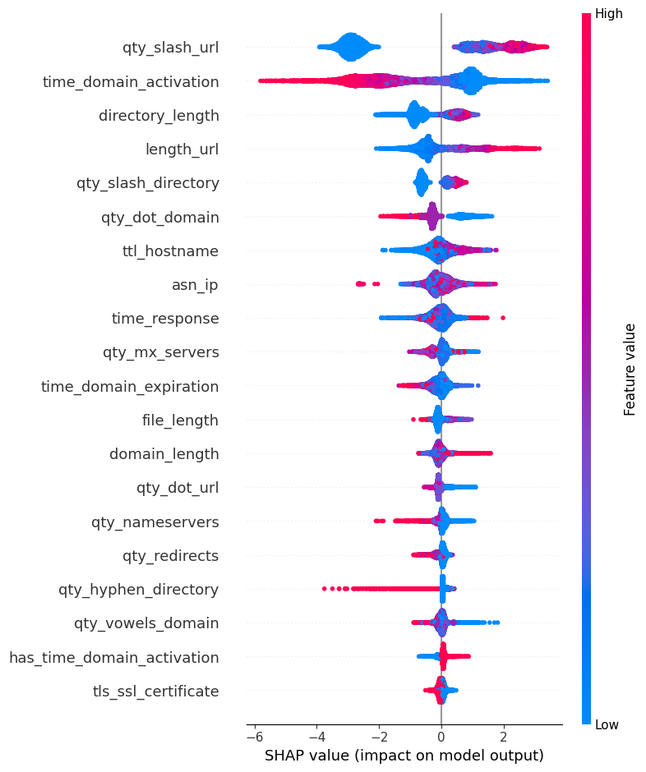
FEATURE IMPORTANCE: SHAP ANALYSIS
>
A little mathematical basis
>
Disadvantage: Doesn’t consider correlations (and there are)
Deep directory structures often hide fake domain
New domains are suspicious
Longer URLs are suspicious
Vertical: Features ranked by importance (top=most)
Horizontal: Impact on prediction. Right → Phishing
Colors: Feature value. Red = High

Slide 17
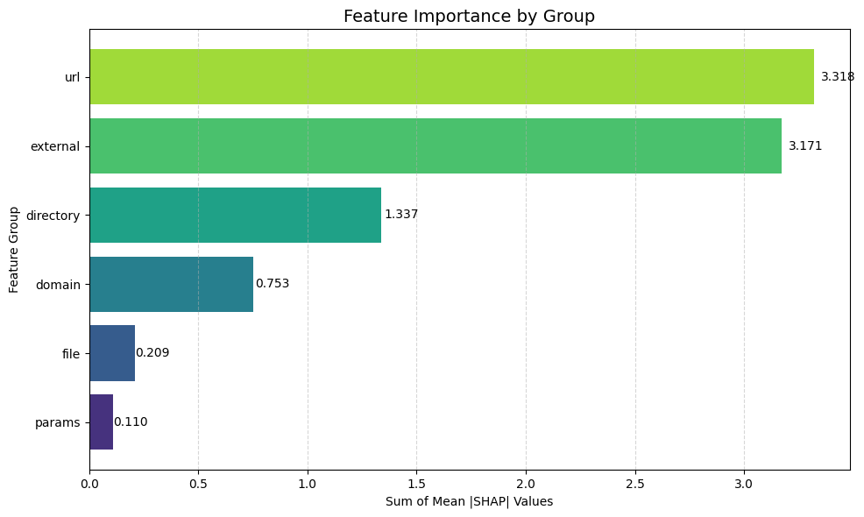
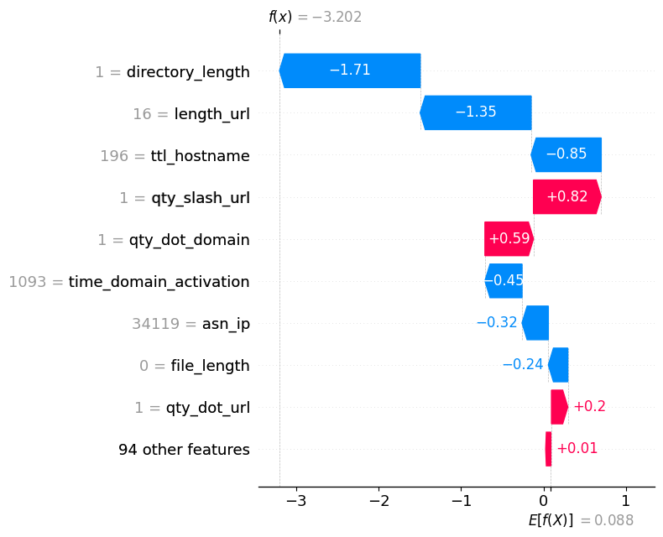
A FEW MORE CAPABILITIES
Error investigation:
1. Start at E[f(x)]: Average dataset score
2. RED: Pushing towards phishing
3. f(x): Final prediction score
Aggregative view:
URL general Structure and External Service Checks are the primary drivers
False Negative
(Missed phishing)

Slide 18







(MY-) FUTURE WORK
ERROR ANALYSIS
ADVERSARIAL TESTING
DEEP LEARNING
Examination of every single FALSE
(A characteristic of good classifiers)
(Cool and-) Essential for understanding vulnerability to sophisticated attacks
Implement NN (LSTM/LLM) on raw URL for powerful semantic analysis
Specialization and research on additional external features

Slide 19



AT LAST
CONCLUSION
A (relatively) modern model identifies phishing effectively based on URL structure and minimal external info.
DISCUSSION
>
Multicollinearity for counting elements (less critical for non-linear models).
>
Customized use-cases –an internal-only model is often sufficient for alerting.
>
Limitations: Method is simplistic; detects a lot of "dumb" attacks.
Top-defense against sophisticated attacks → include content analysis.

Slide 20

QUESTIONS

